Slide 1
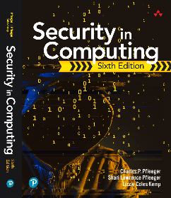
Security in Computing Sixth Edition
Charles P. Pfleeger
Shari Lawrence Pfleeger
Lizzie Coles-Kemp
Chapter 5: Operating Systems

Slide 2
In This Chapter
Operating system structure and design
Object protection: virtualization, sharing
Memory protection: registers, paging, segmentation
Design qualities: modularity, layering, kernelization
Trusted systems: TCB, reference monitor, trusted path, object reuse, evaluation criteria
Rootkits: power, design

Slide 3
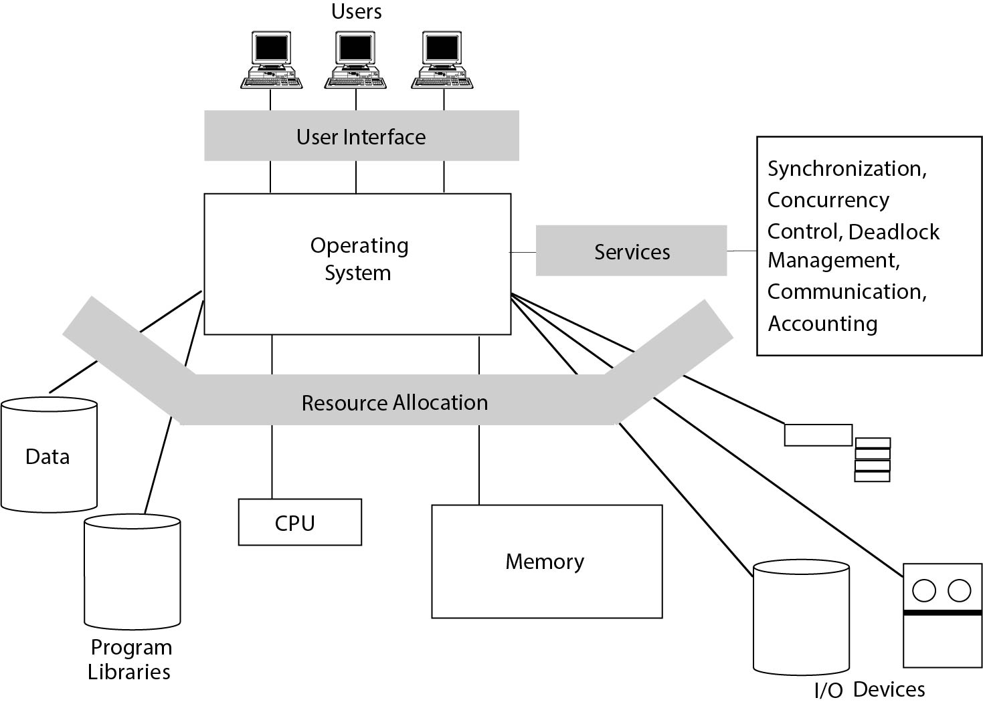
Security in Operating Systems
FIGURE 5-1 Operating System Functions

Slide 4
Operating Systems Functions
Enforced sharing
Interprocess communication and synchronization
Protection of critical operating system data
Guaranteed fair service
Interface to hardware
User authentication
Memory protection
File and I/O device access control
Allocation and access control to general objects

Slide 5
Protected Objects in Multiprogramming
Memory
Sharable I/O devices, such as disks
Serially reusable I/O devices, such as printers and tape drives
Sharable programs and subprocedures
Networks
Sharable data

Slide 6
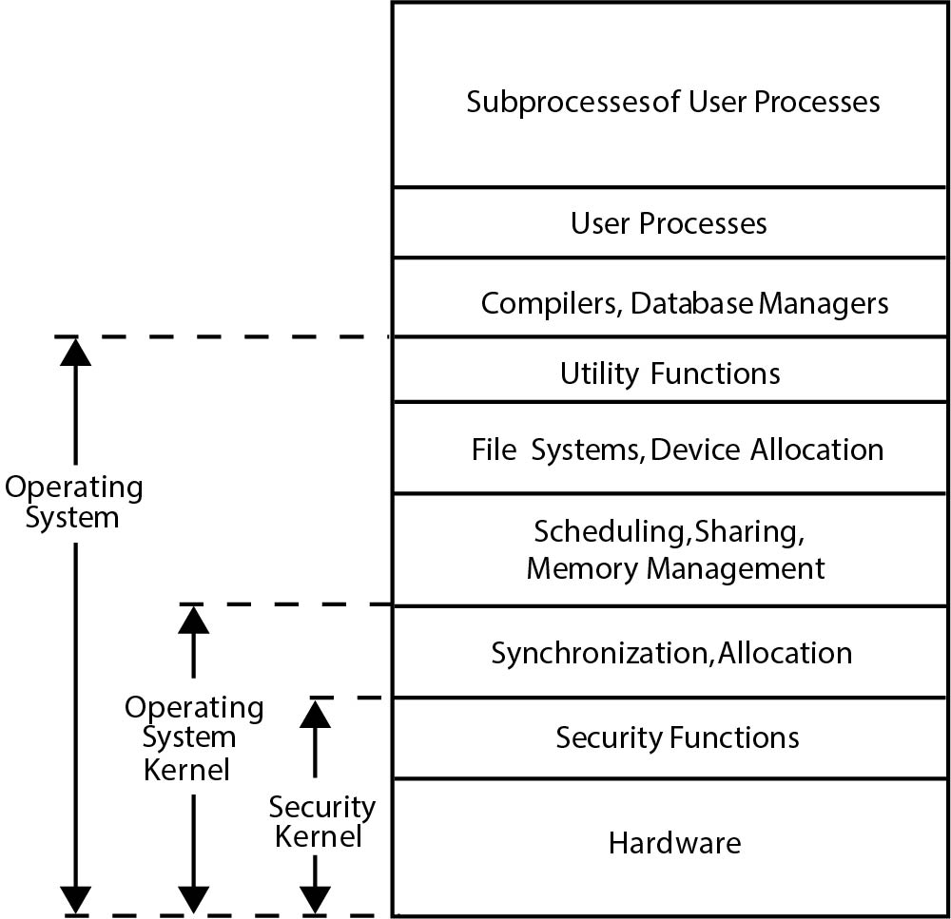
Layered Operating System
FIGURE 5-2 Layered Operating System

Slide 7
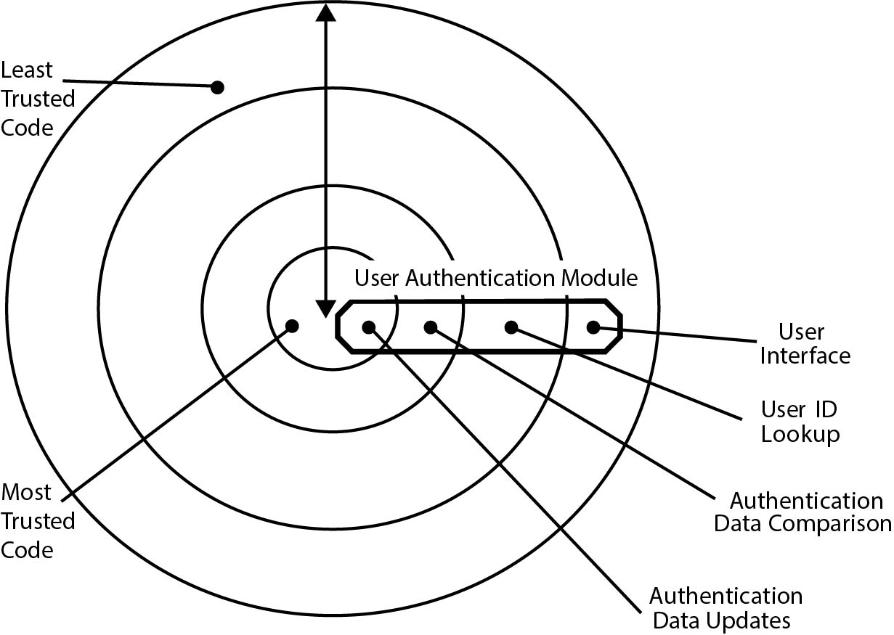
Layered Operating Systems (cont'd)
FIGURE 5-3 Authentication Functions Spanning Layers in an Operating System

Slide 8
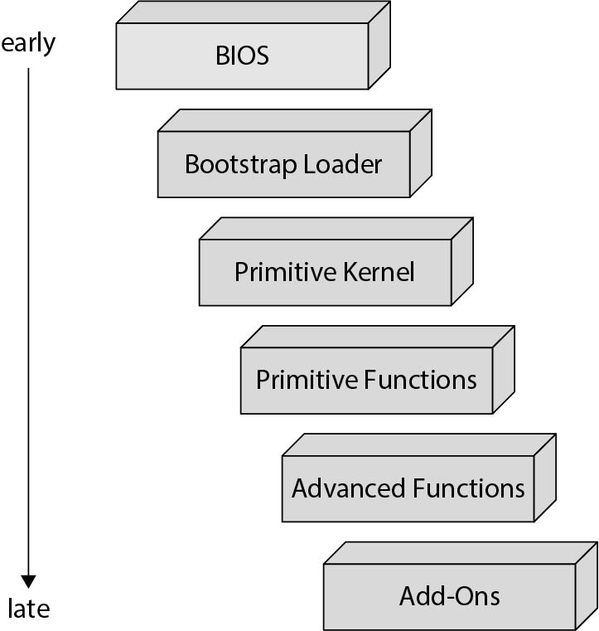
Layered Operating Systems (cont'd)
FIGURE 5-5 Operating System Loaded in Stages

Slide 9
Operating System Tools for Security
Audit log
Virtualization:
Virtual machine
Hypervisor
Sandbox
Honeypot
Separation and sharing

Slide 10
Separation in Operating System
Physical separation: Different processes use different physical objects
Temporal separation: Processes having different security requirements are executed at different times
Logical separation: Users operate under the illusion that no other processes exist, as when an operating system constrains a program’s accesses so that the program cannot access objects outside its permitted domain
Cryptographic separation: Processes conceal their data and computations in such a way that they are unintelligible to outside processes

Slide 11
Hardware Protection of Memory
Fence
Base/bounds registers
Tagged architecture
Virtual memory
Segmentation
Paging
Combined paging with segmentation

Slide 12
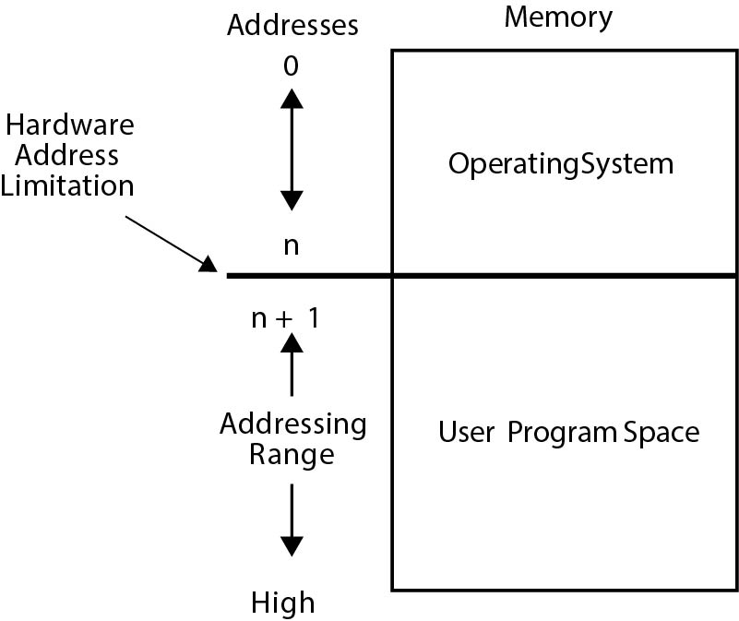
Example: Fence Protection
FIGURE 5-6 Fence Protection

Slide 13
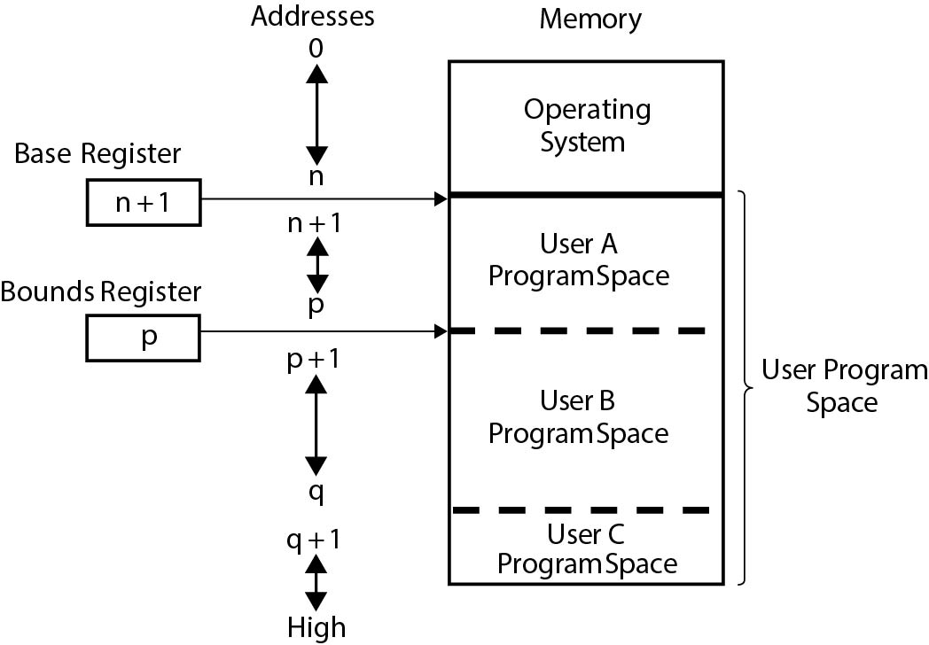
Example: Base and Bounds Registers
FIGURE 5-8 Base and Bounds Registers

Slide 14
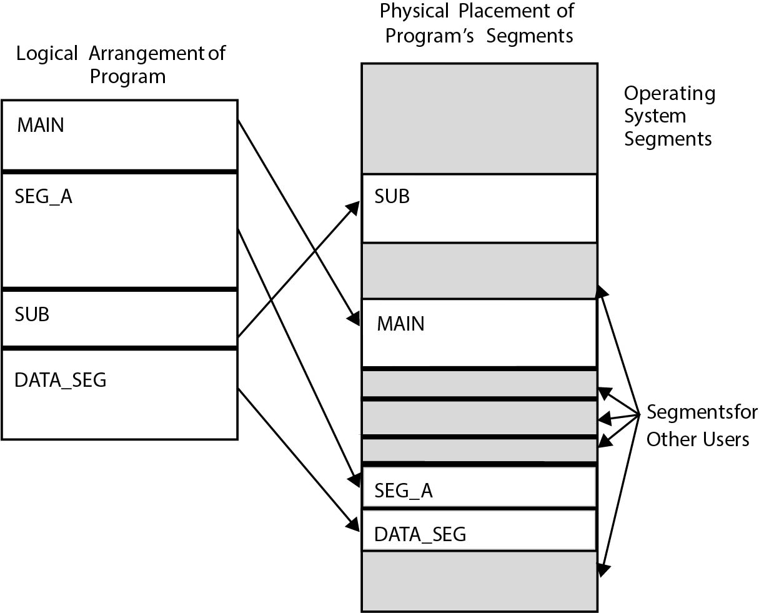
Example: Segmentation
FIGURE 5-11 Segmentation

Slide 15
Security in the Design of Operating Systems
Simplicity of design
Layered design
Conventional (nonhierarchical)
Hierarchical
Kernelized design
Reference monitor
Correctness and completeness
Secure design principles

Slide 16
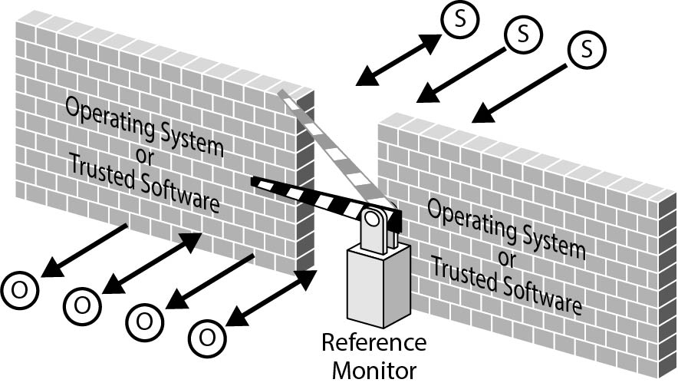
Reference Monitor
FIGURE 5-15 Reference Monitor

Slide 17
Secure Design Principles
Least privilege
Economy of mechanism
Open design
Complete mediation
Permission-based
Separation of privilege
Least common mechanism
Ease of use

Slide 18
Rootkits
Root (in Unix): Identity of the most privileged subject
Rootkit characteristics:
Evade detection
Operate unchecked
Exploit permissions
Usurp control

Slide 19
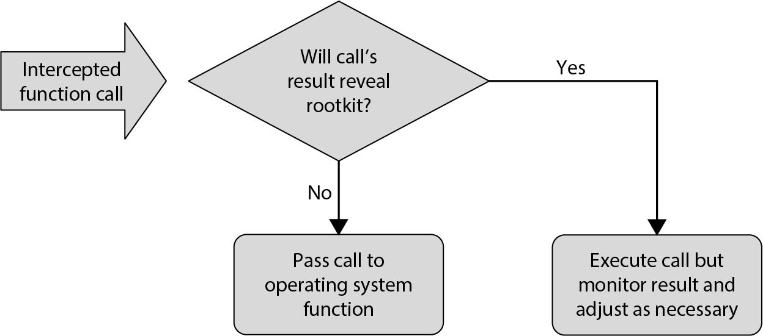
Example: Rootkit Filtering File
FIGURE 5-22 Rootkit Filtering File Description Result

Slide 20
Summary
Survey of operating systems for important security concept development
Operating systems as place of detailed analysis of access control
Operating system design strategies
Strength of the operating system due to tight integration with hardware, simple design, and security focus
Advantage of self-contained operating system on a distinct platform

